Slide 1

Plateforme d’engagement et de gestion de membres
pour les grandes organisations.

Slide 2
APERÇU GÉNÉRAL DE LA SOLUTION
Une solution multi-plateformes et multi-niveaux pour l’engagement et la gestion d’organisations bénéficiant d’une large base de membres.
Connectik fournit une plateforme qui simplifie et rationalise l’enregistrement, les adhésions, les donations, le volontariat et la communication quelle que soit sa localisation ou son appareil.
Une solution sécurisée développée pour une adaptabilité de haut niveau comme le requiert le fonctionnement de grandes Organisations ou entreprises.
Plateformes Web, iOS & Android
Conforme aux normes de sécurité de paiement par carte Payment Card Industry (PCI)
Déployée sur Amazon Web Service (AWS) avec Amazon Virtual Private Cloud
Base de données encryptée et stockage sécurisé
Grande puissance d’analyse
Capacités de recherche et de recommandation
Outils de collaboration et de communication

Slide 3
Application Croix-Rouge / Croissant Rouge

Slide 4







Red cross & red crescent key figures and objectives
RCRC Key Figures
Mission of National Red Cross or Red Crescent Societies
2025 objectives – 190 National Societies reach 1 billion members
Over 200 million members
17 million active volunteers
Over 150 million people/year have access to pay-for services of the Red Cross for total revenues of 32.5 billion CHF/year. Only 19 National Societies have proper communication and resource mobilization capacities to ensure quality services to people.
Contribute to the development of its country in times of peace or normalcy.
Assist the most vulnerable citizens or communities affected by man-made or natural hazards.
Members
Support one another with the help of the IFRC Secretariat for Coordination.
In 2012, total income in excess of
19 highest income National Societies
CHF 32.5 billion
CHF 31.3 billion
Revenues
190
National
Societies
190 National Red Cross/Red Crescent Societies – with 100 National Societies that have proper communication and resource mobilization capacities to ensure quality services to people.
10%
of National
Societies
96%
of
total income
Account for
1 billion members take active steps to contribute and support activities of the Red Cross & Red Crescent Societies and have access to pay-for services of the Red Cross for a total market of 100 billion CHF/year
Onkly 10% of National Societies with highest income account for 96% of total income of all National Red Cross and Red Crescent Societies.
1
Billion
People
(Based on data from 168 National Societies)

Slide 5

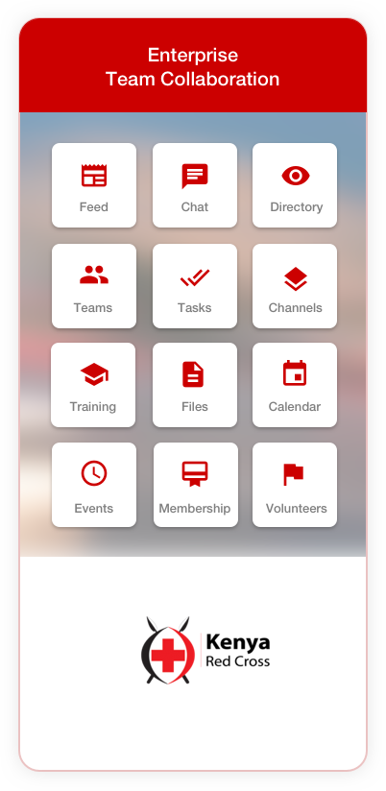
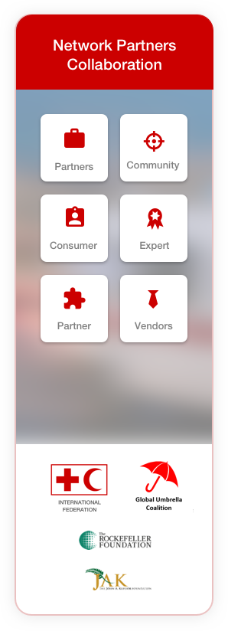
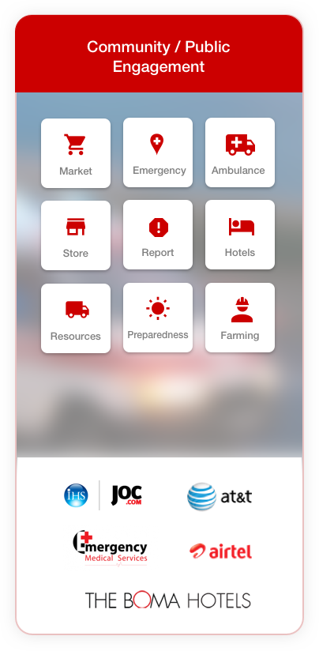
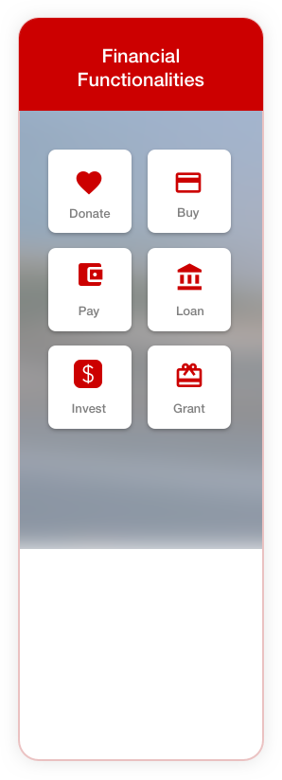
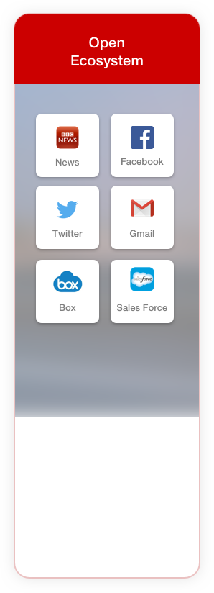
Humanitarian – SOCIAL organizations

Slide 6
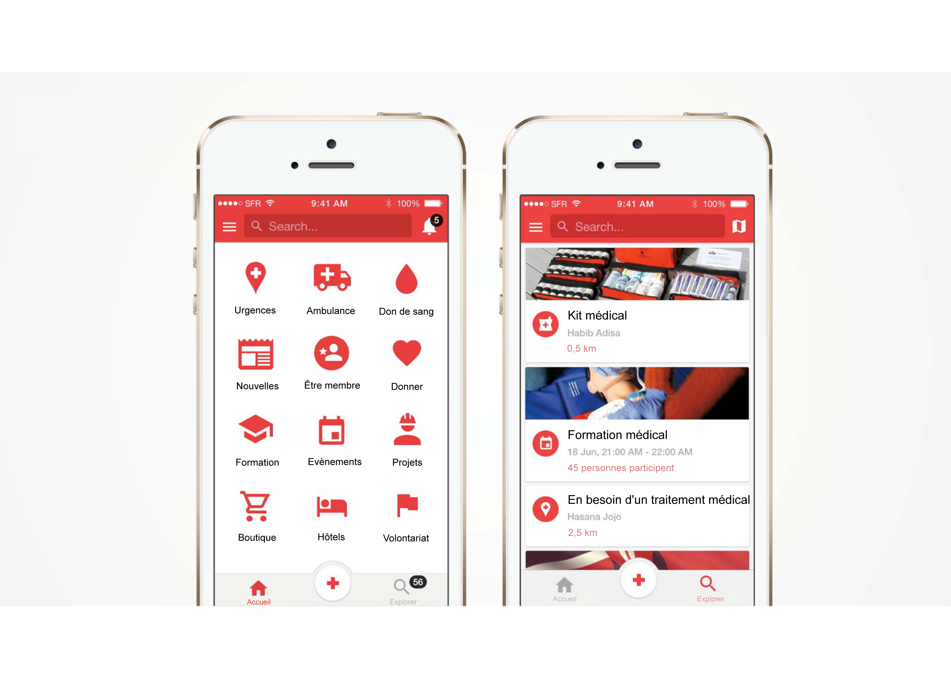
COMMUNICATION
COMMUNITY APPLICATION

Slide 7
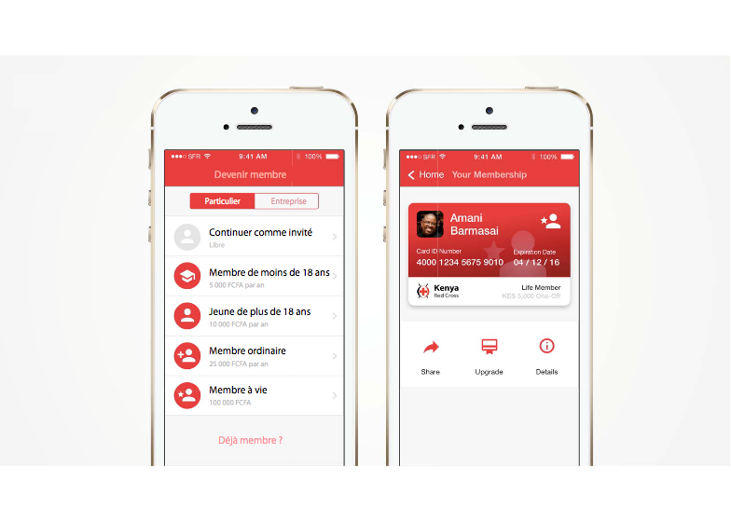
MEMBERSHIP
COMMUNICATION
COMMUNITY APPLICATION
COMMUNITY APPLICATION

Slide 8
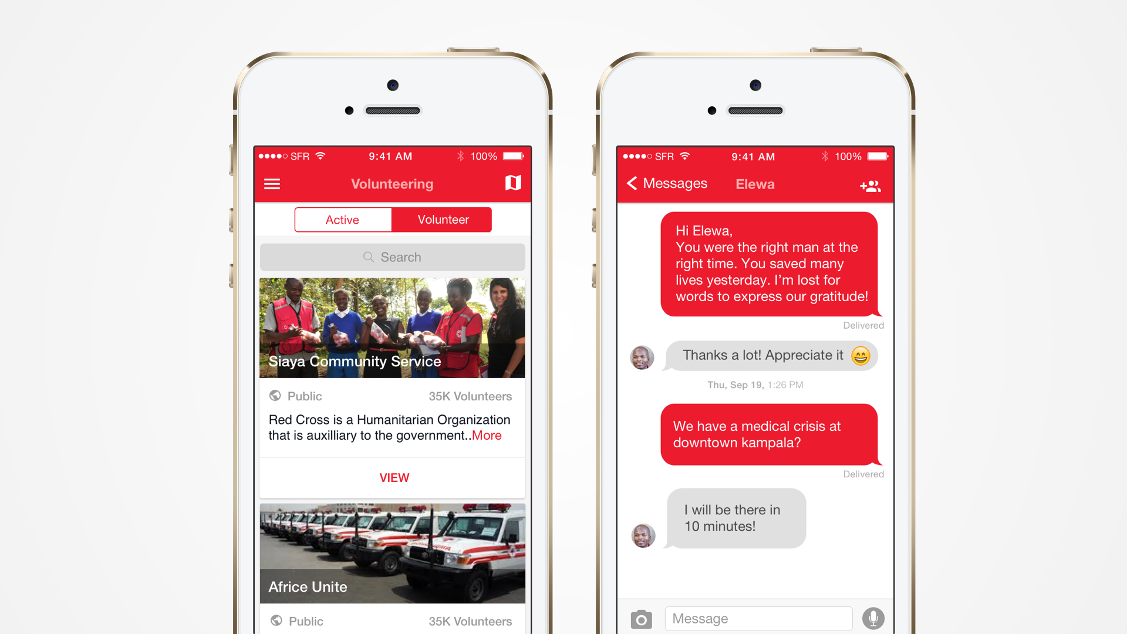
COMMUNICATION
COMMUNITY APPLICATION

Slide 9
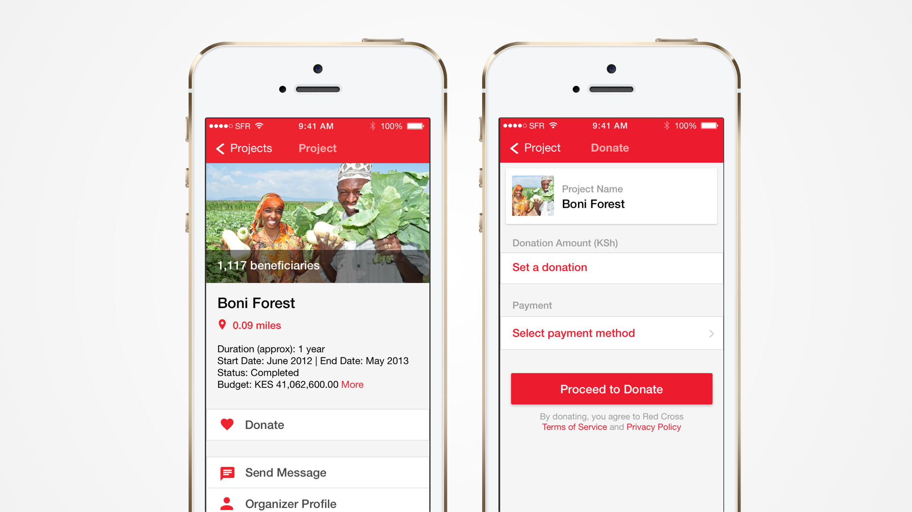
DONS & PAIEMENT
COMMUNITY APPLICATION

Slide 10
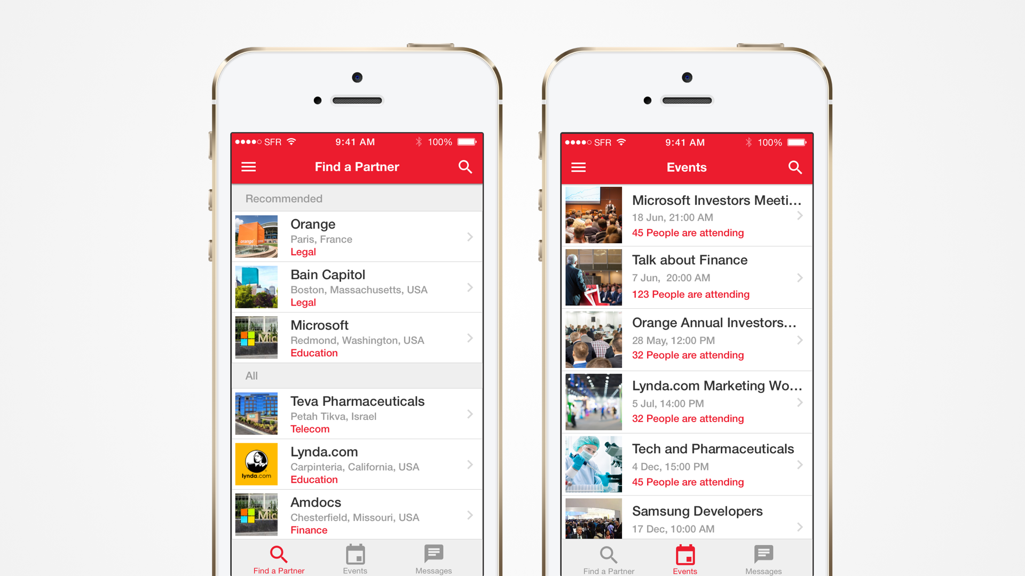
PARTENAIRES COMMERCIAUX
PARTNERSHIP APPLICATION

Slide 11
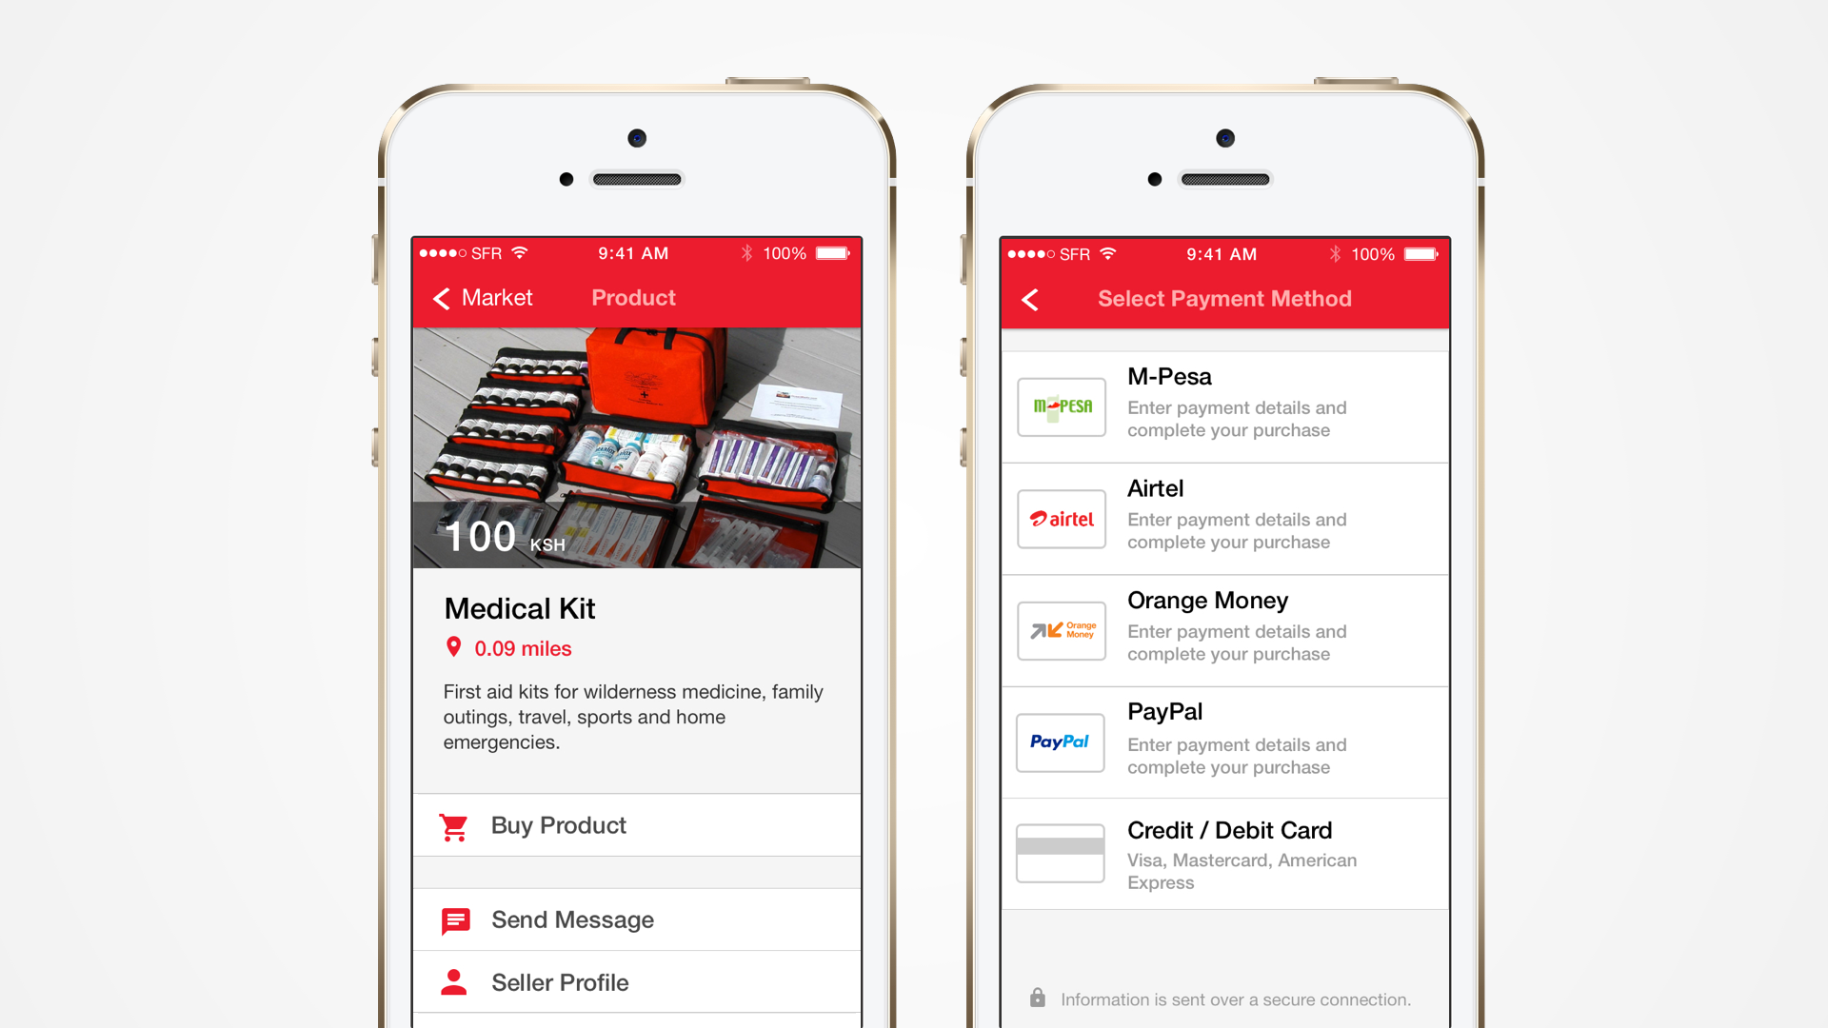
BOUTIQUE ONLINE
COMMUNITY APPLICATION

Slide 12
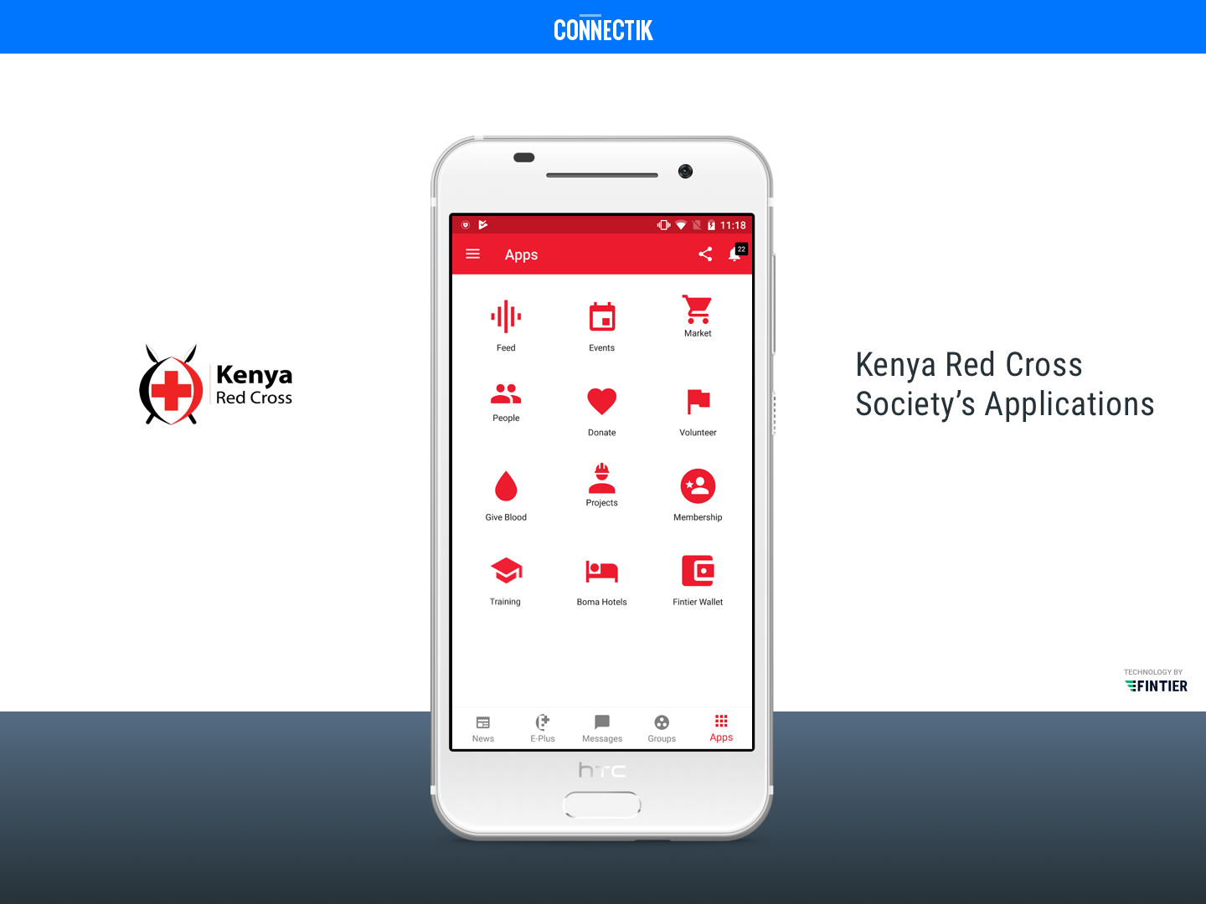

Slide 13
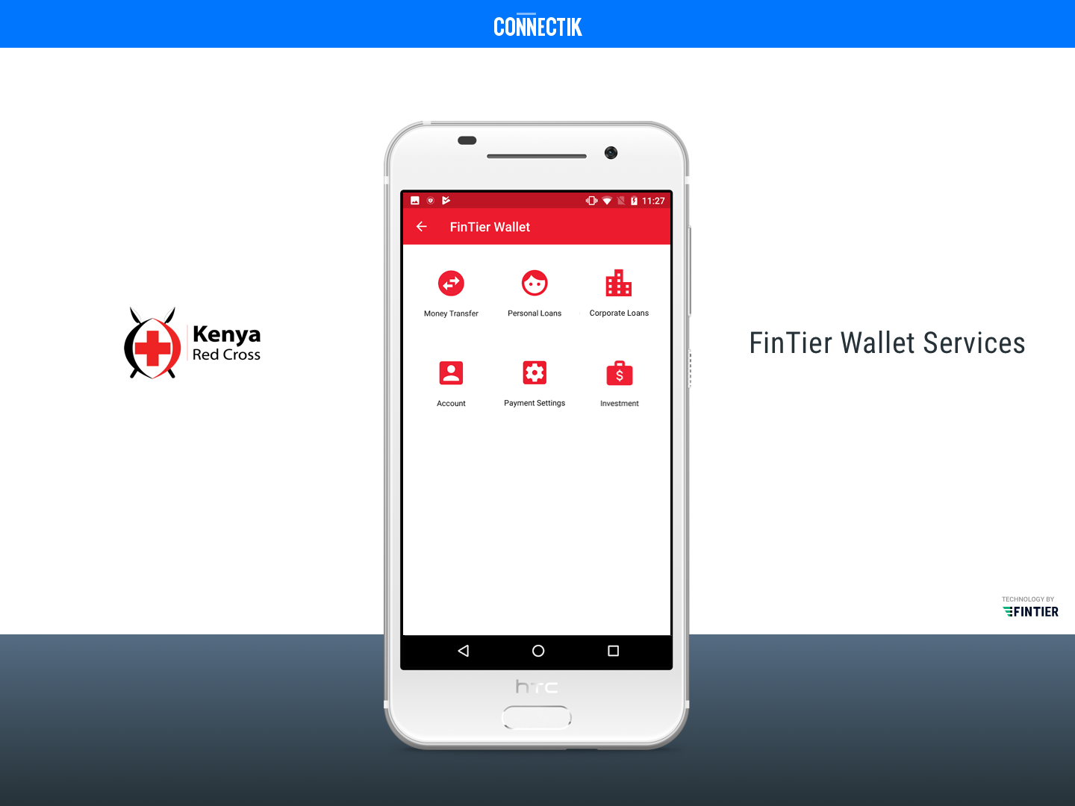

Slide 14
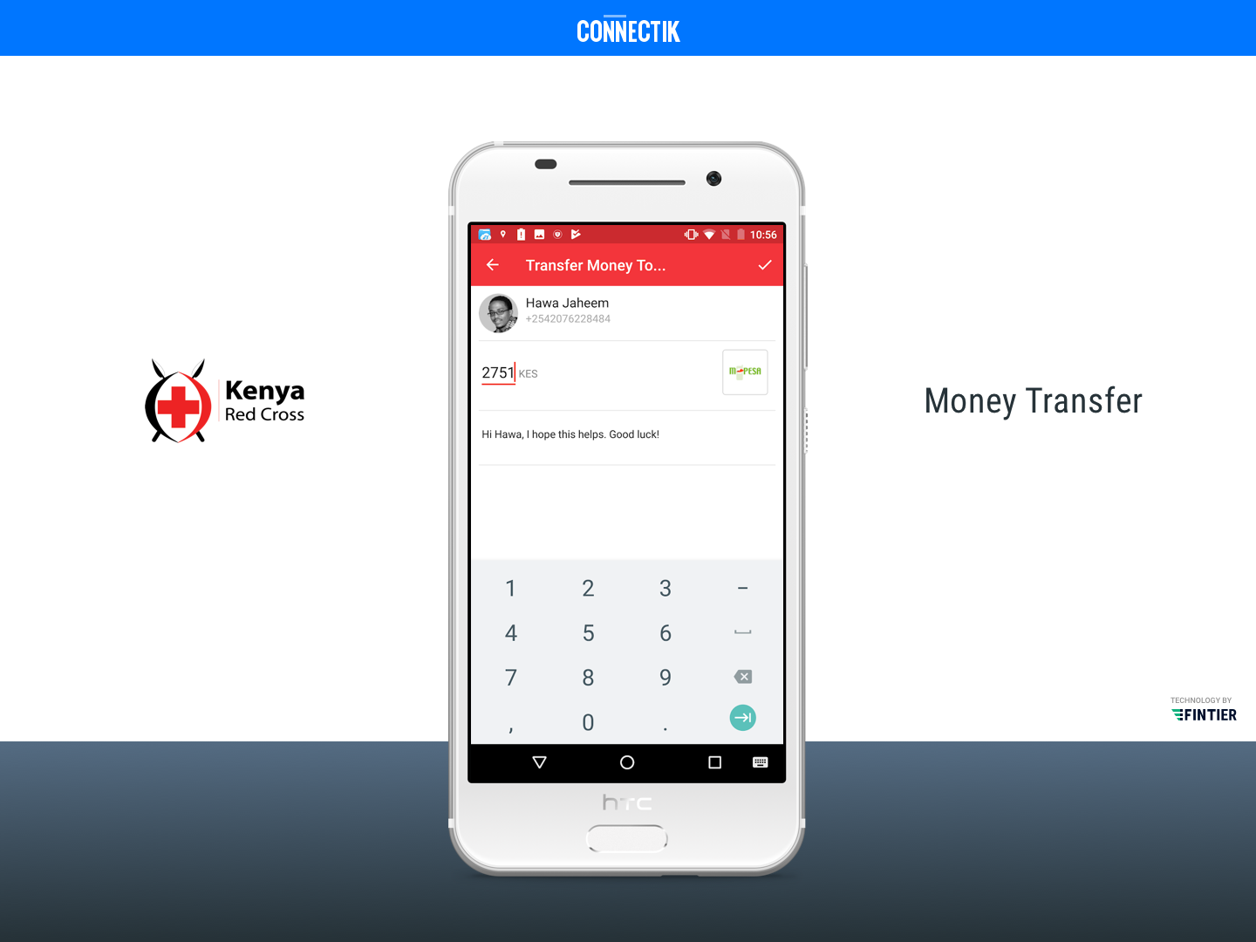

Slide 15
PLATEFORME DU PERSONNEL CR/CR

Slide 16
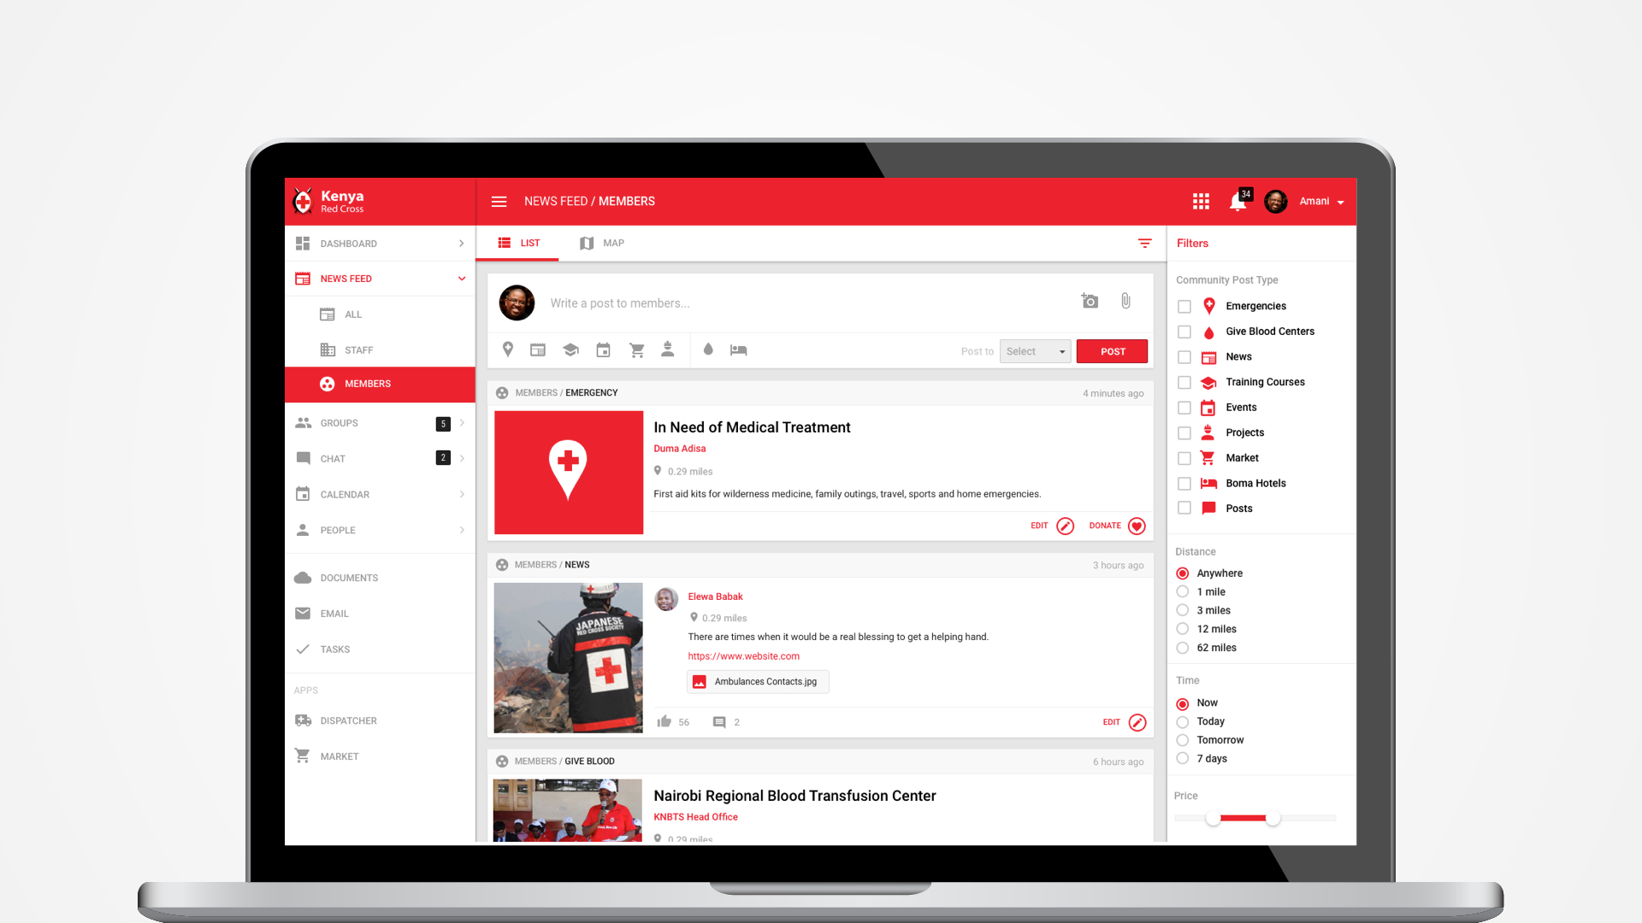
PRODUCTIVITÉ
STAFF APPLICATION

Slide 17
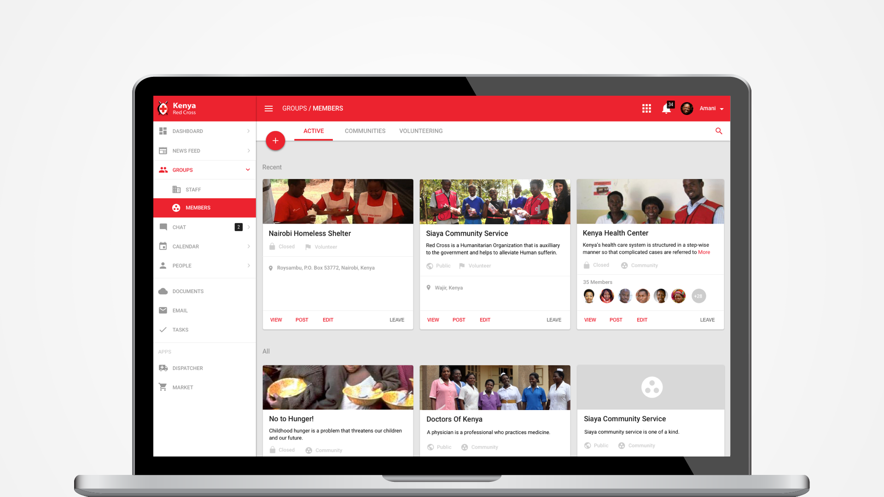
COLLABORATION
STAFF APPLICATION

Slide 18
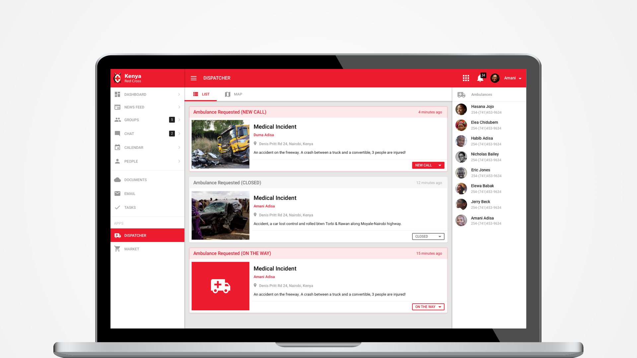
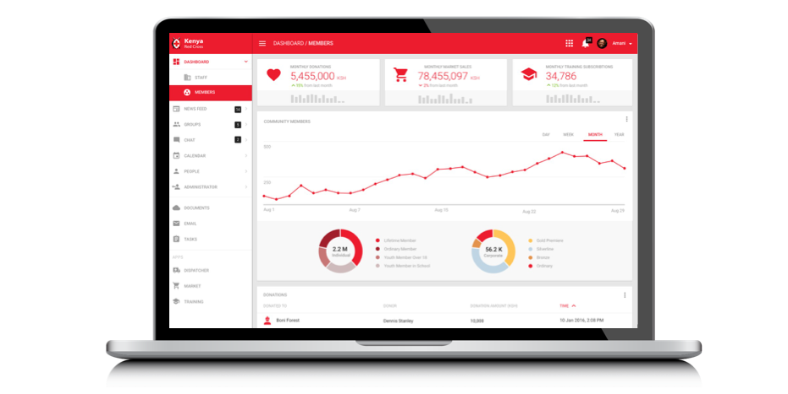
ANALYSES & VISION
STAFF APPLICATION

Slide 19
CENTRE DE RÉPARTITION (CUSTOMIZATION)
STAFF APPLICATION

Slide 20
MERCI

